Slide 1
Paper Figures
40 Topics

Slide 2
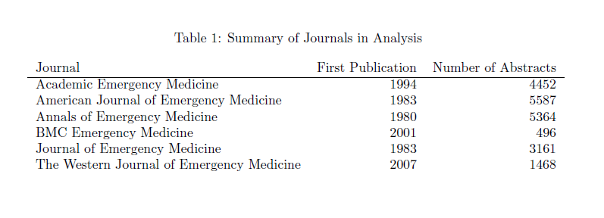
Table 1

Slide 3
Table 2

Slide 4
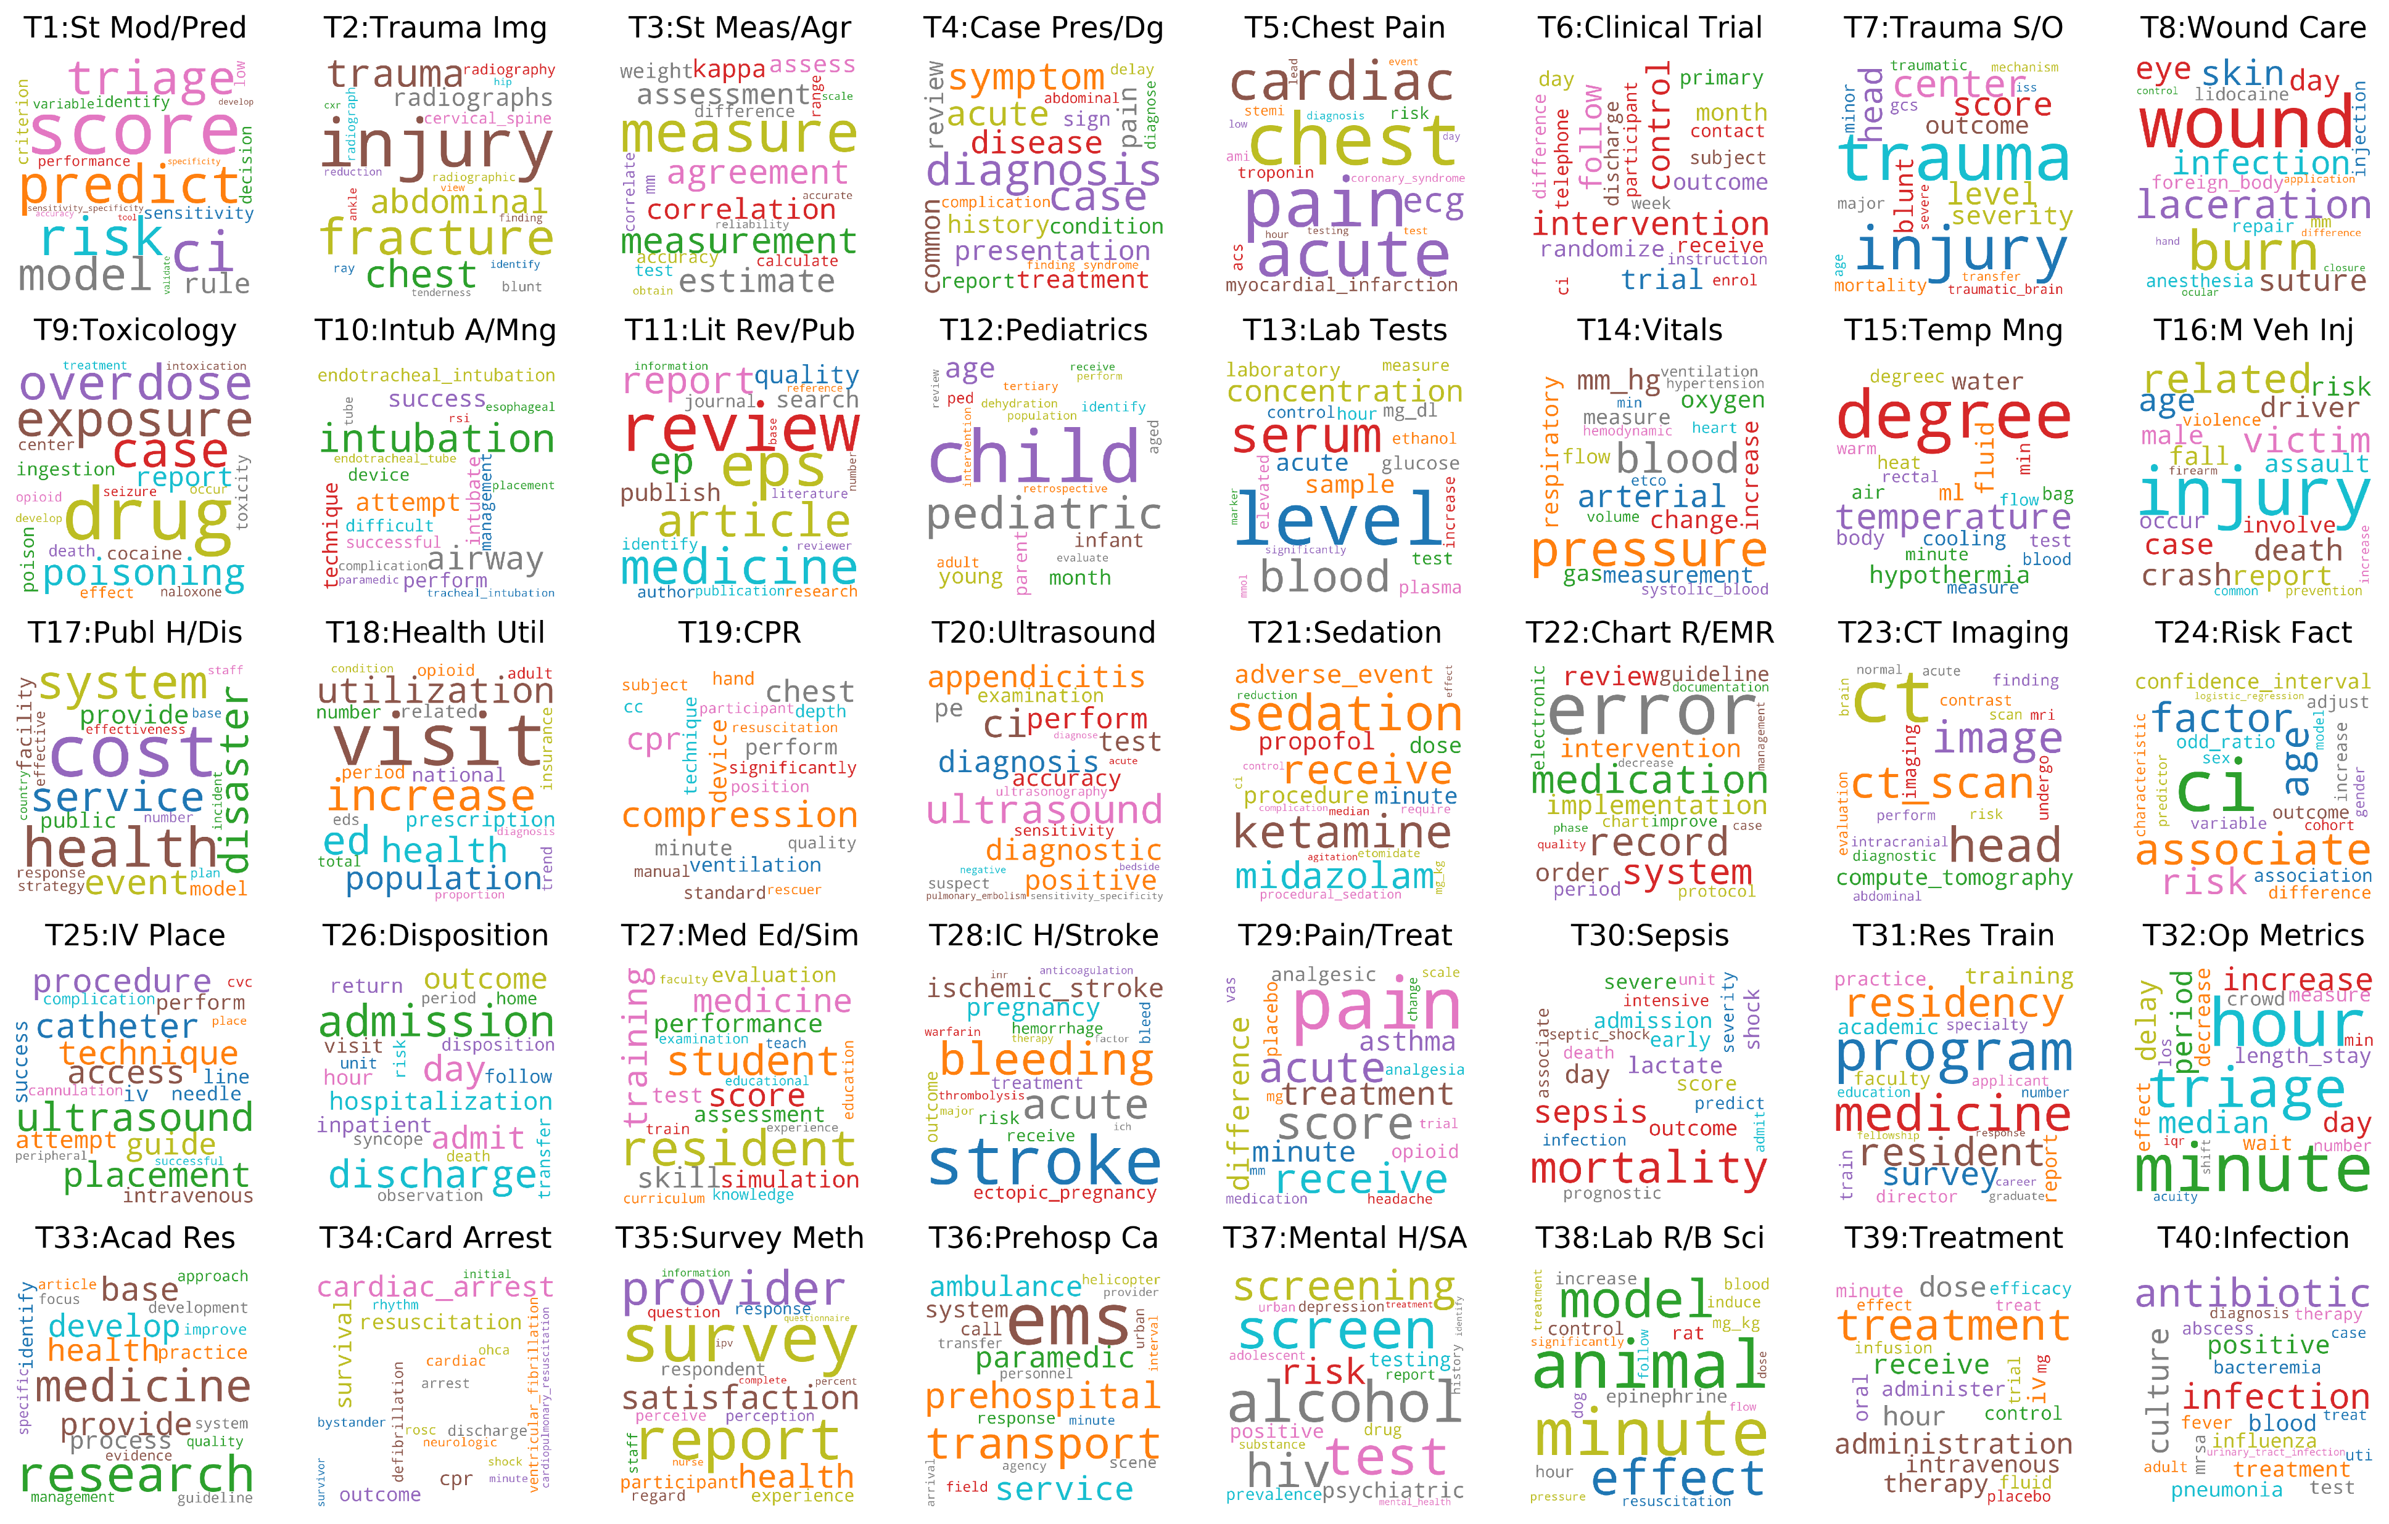
Figure 1 Word Clouds

Slide 5
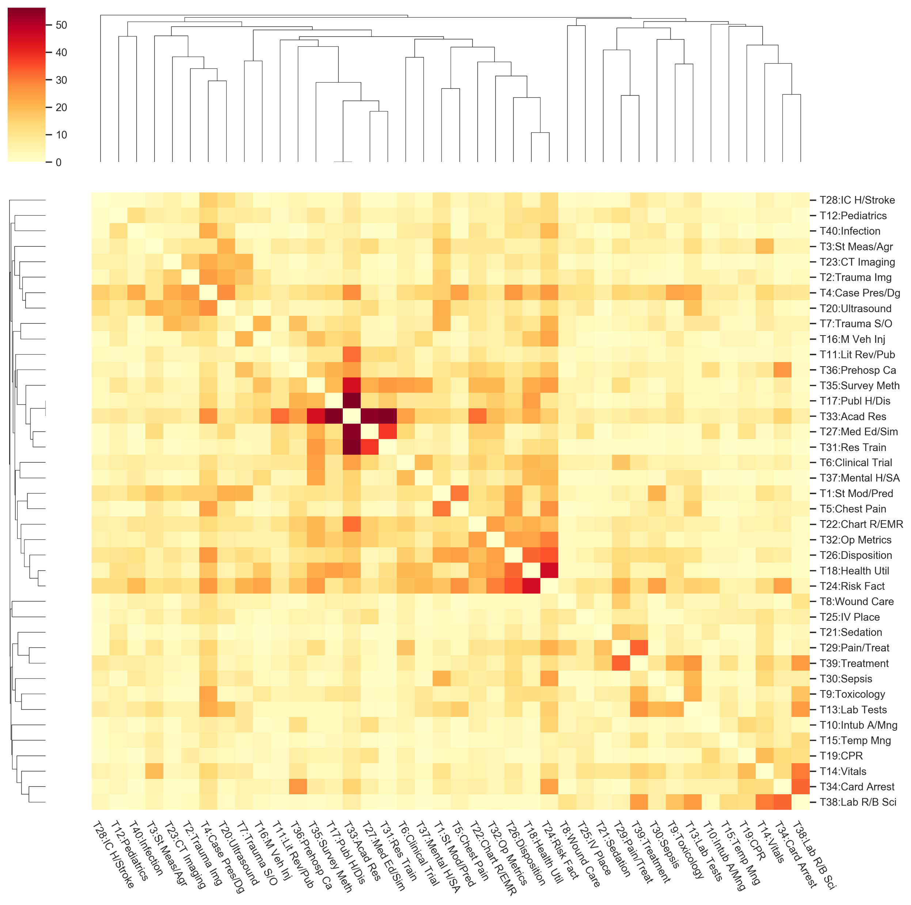
Figure 2 Topic cluster heatmap

Slide 6
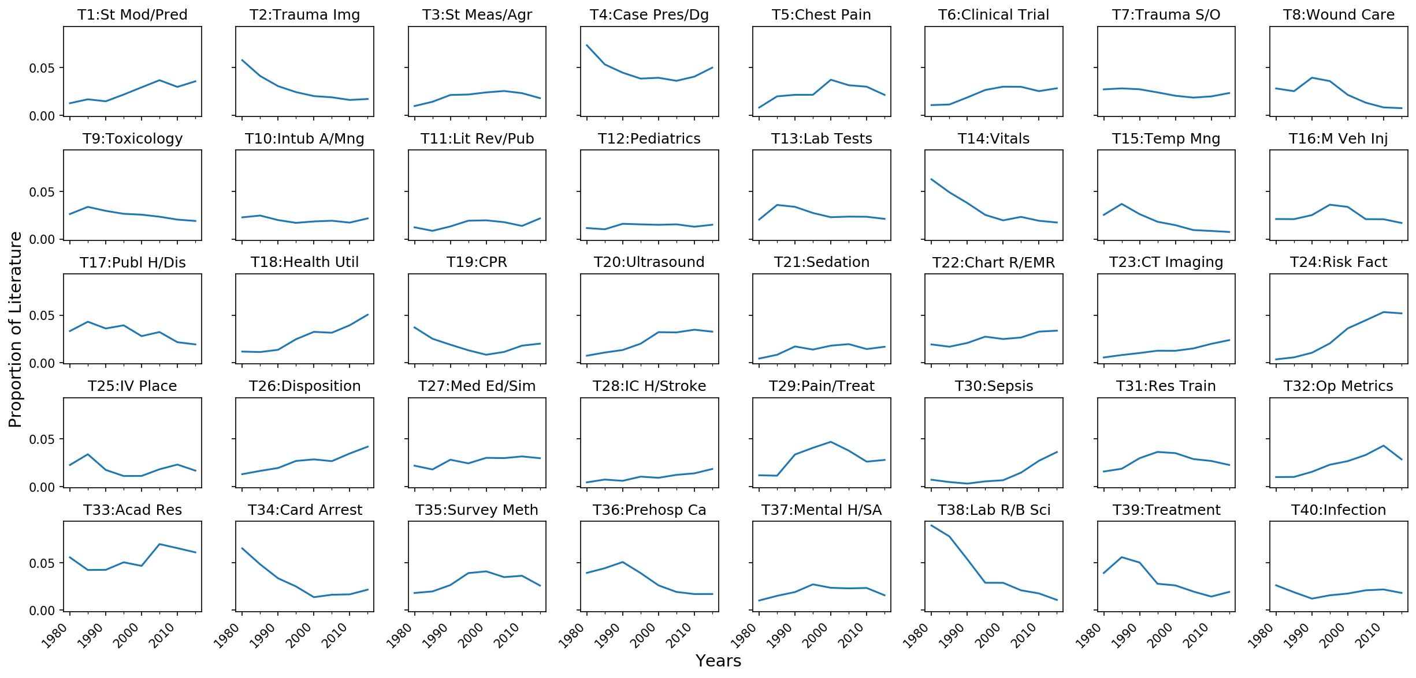
Figure 3 Topic Trends

Slide 7
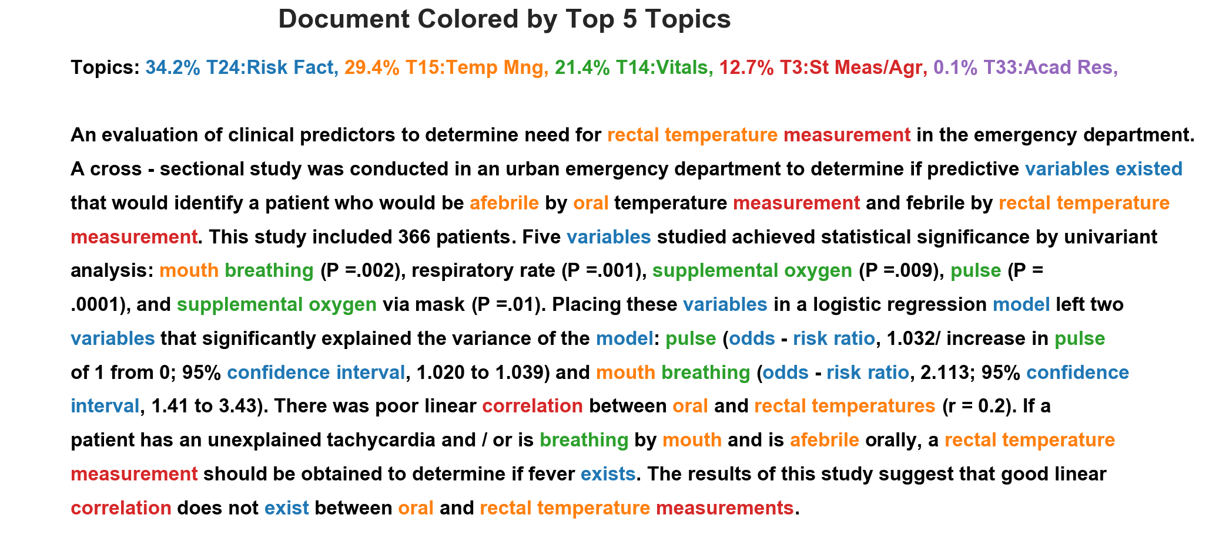
Figure 4 example Paragraph 6545

Slide 8
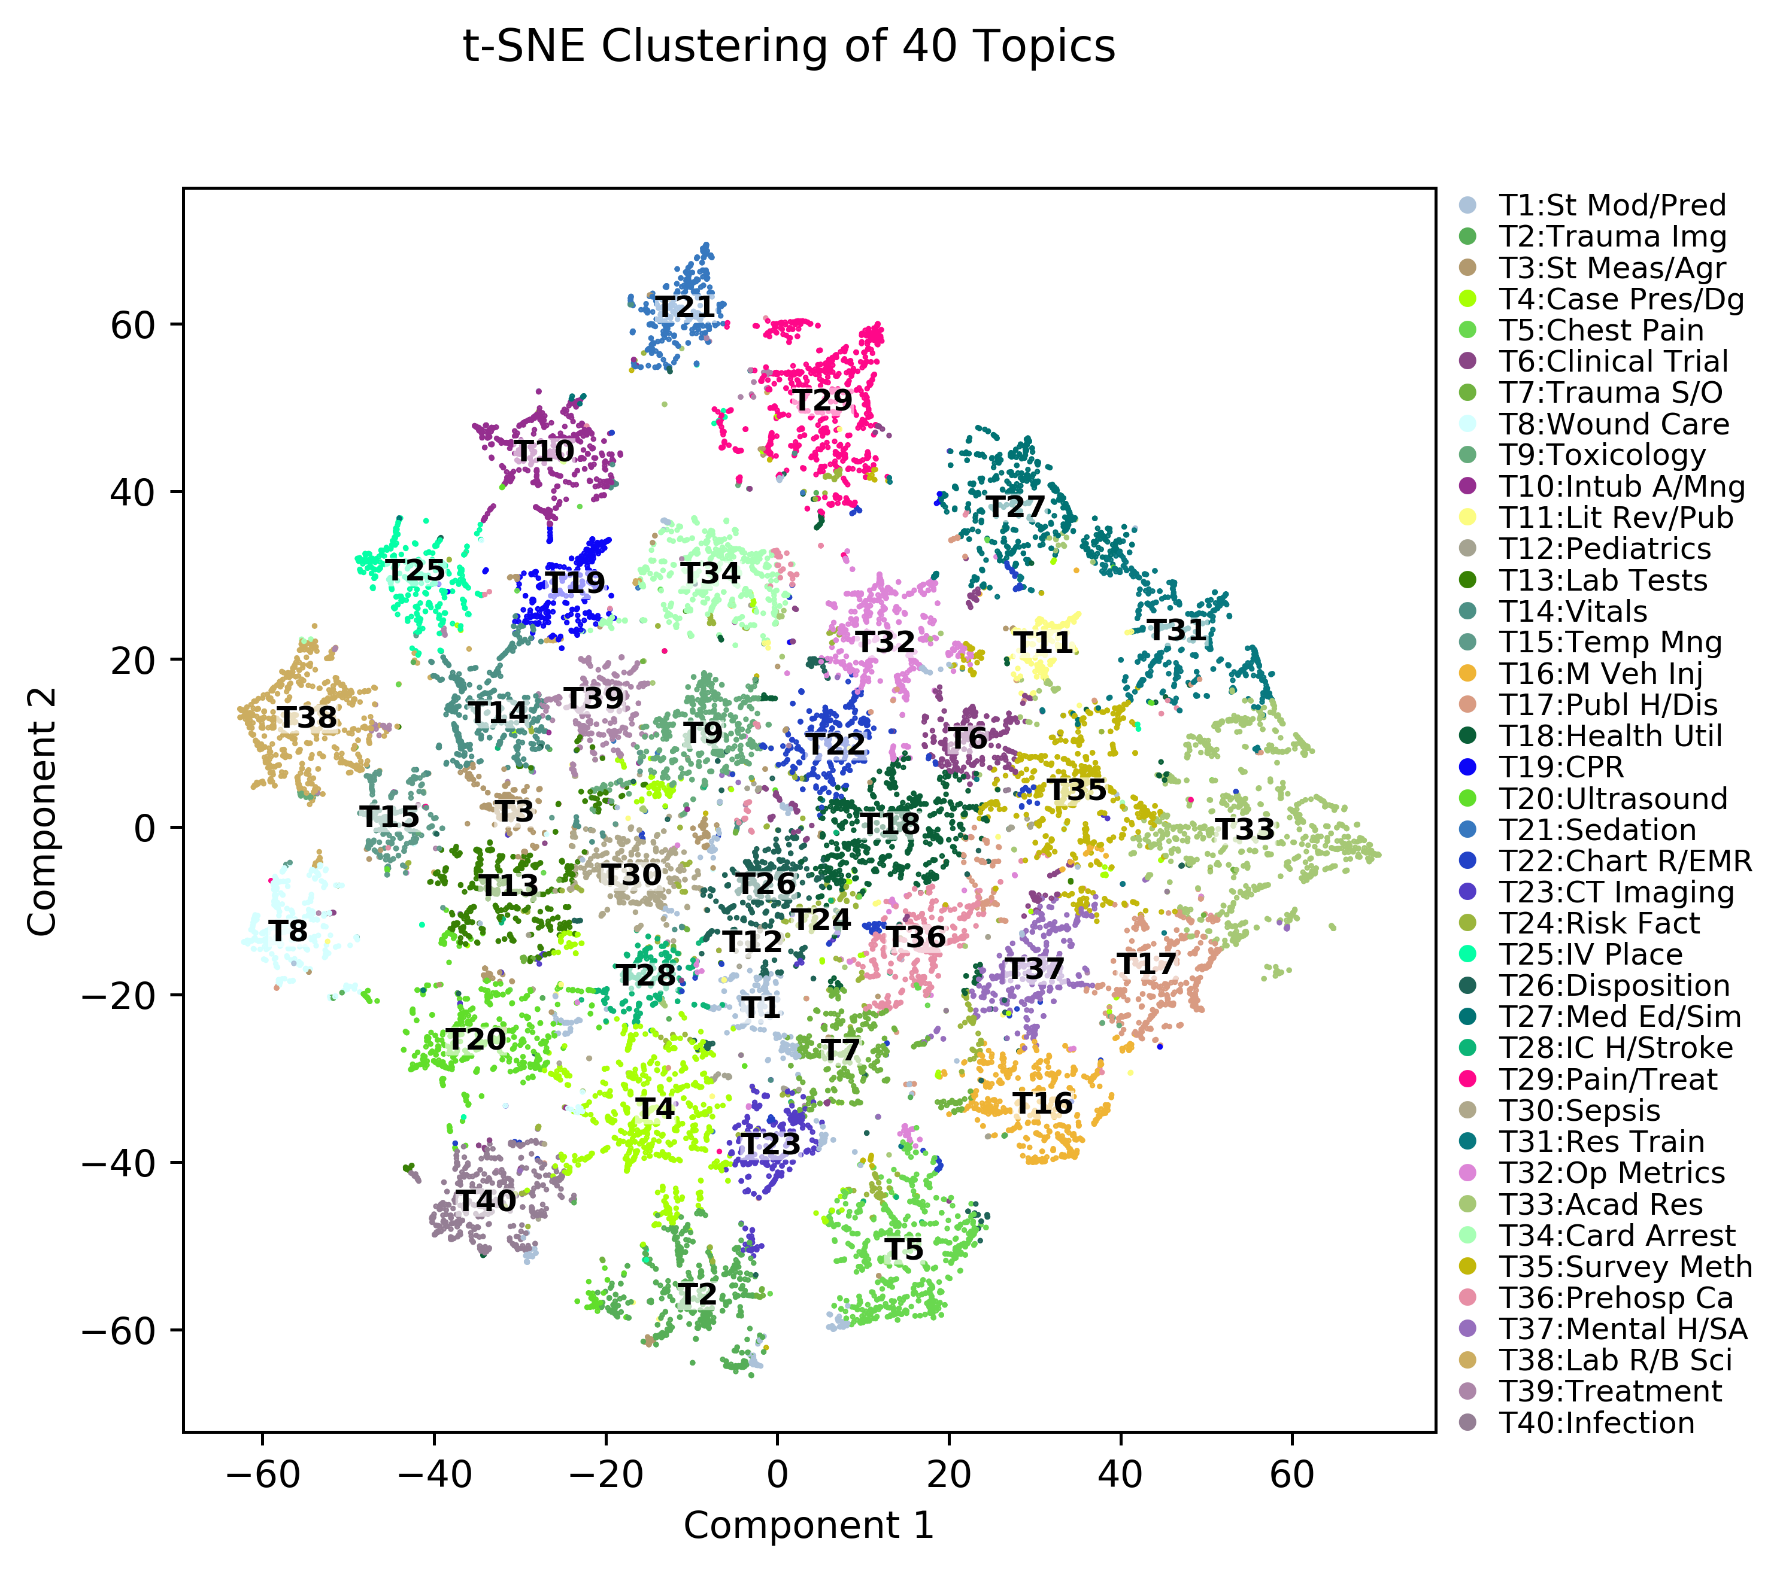
Figure 5 t-SNE cluster of documents

Slide 9
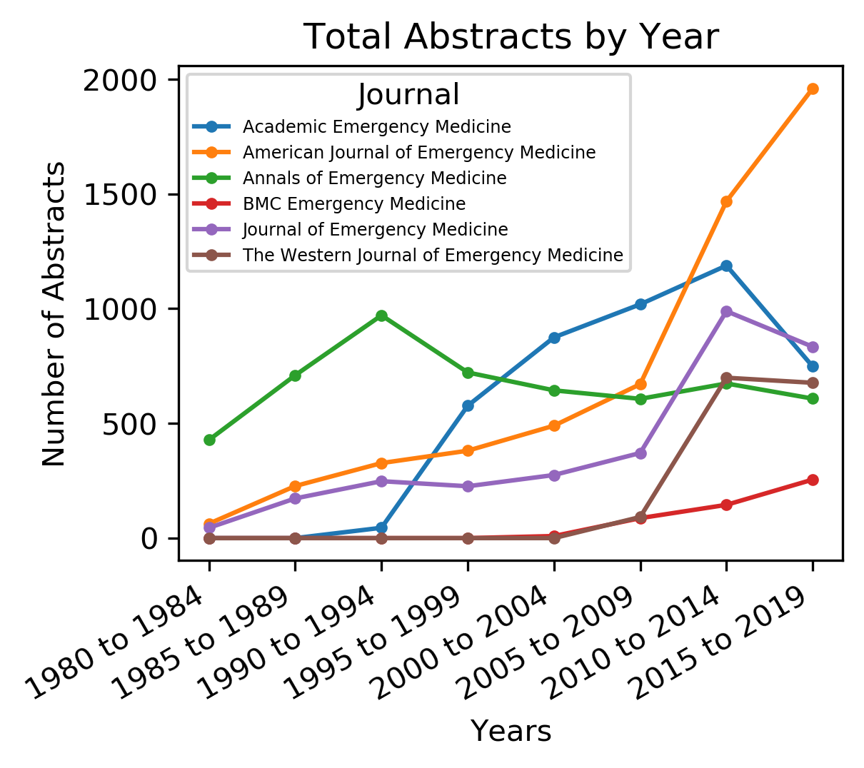
Sup Figure 1

Slide 10
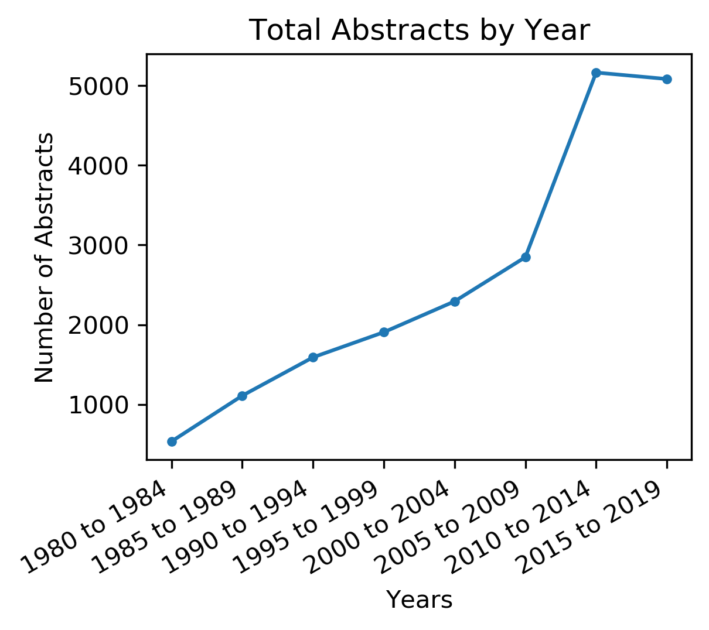
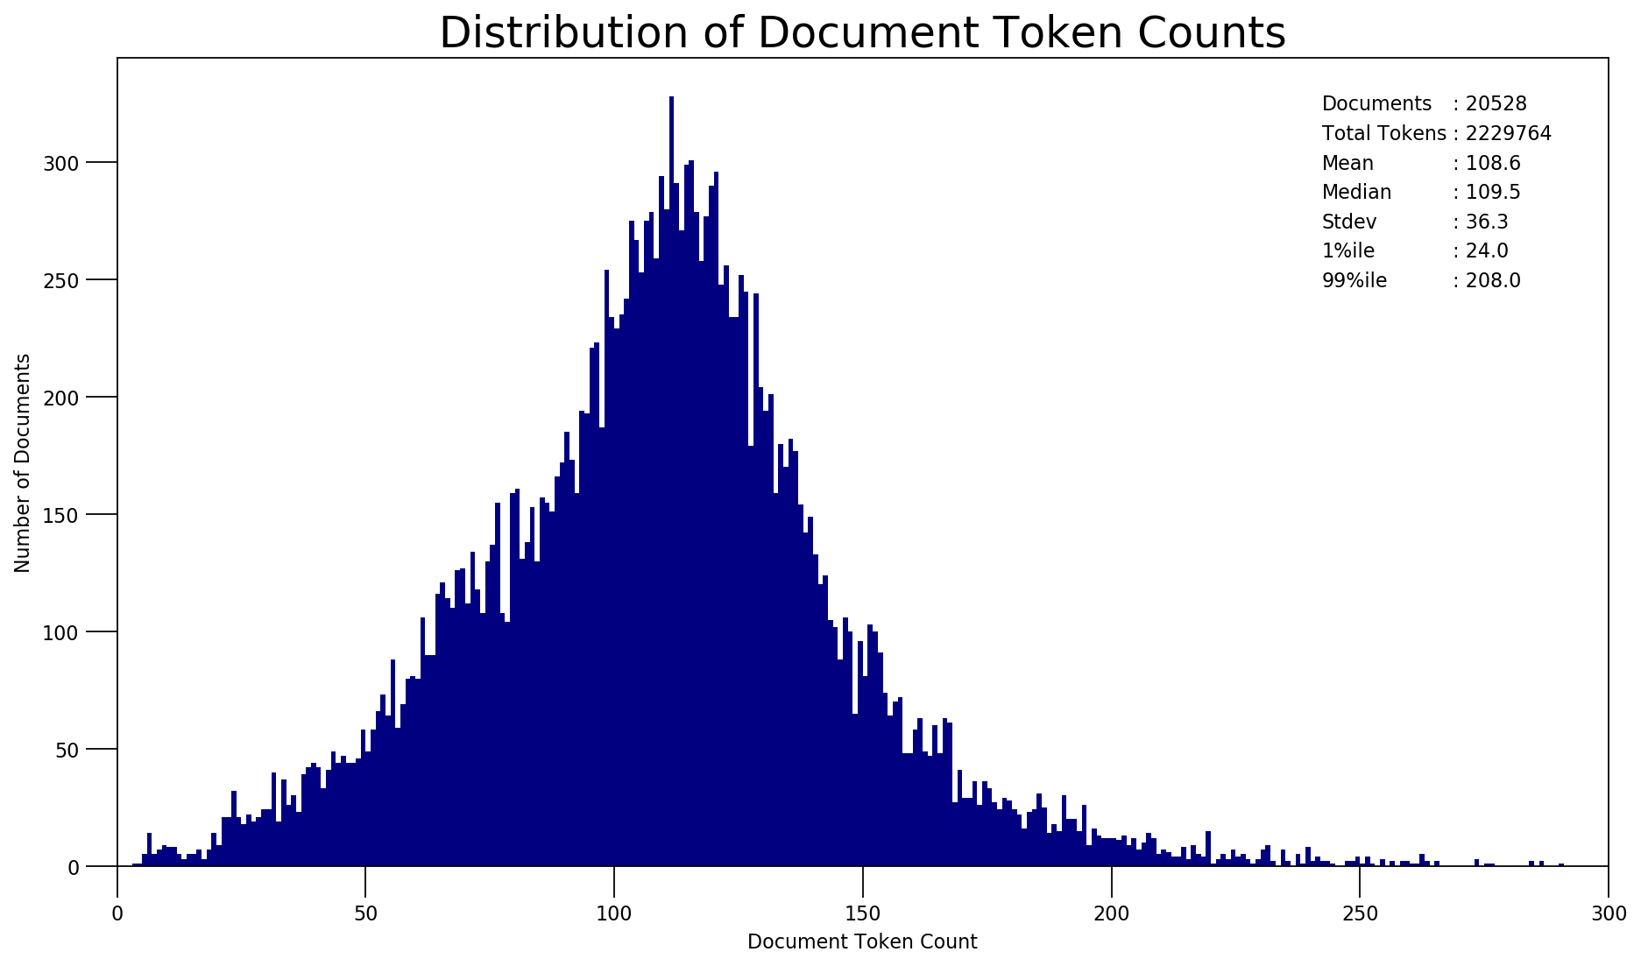
Supplemental Figure 1

Slide 11
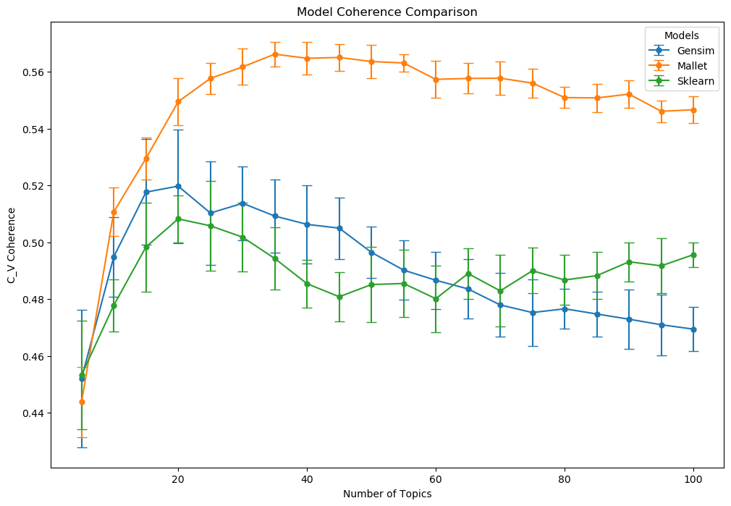
Supplemental Figure 2

Slide 12
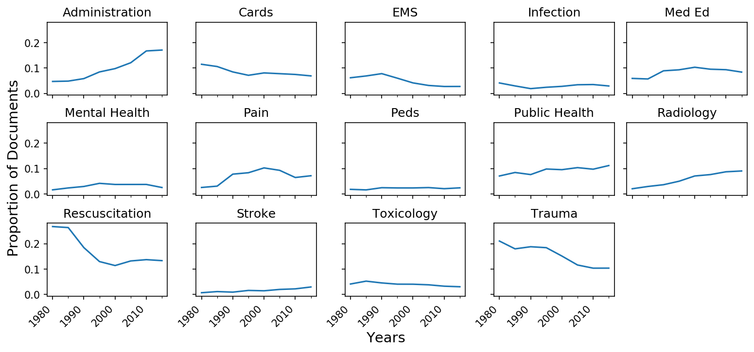
Sup Figure 4 Research Theme Trends

Slide 13
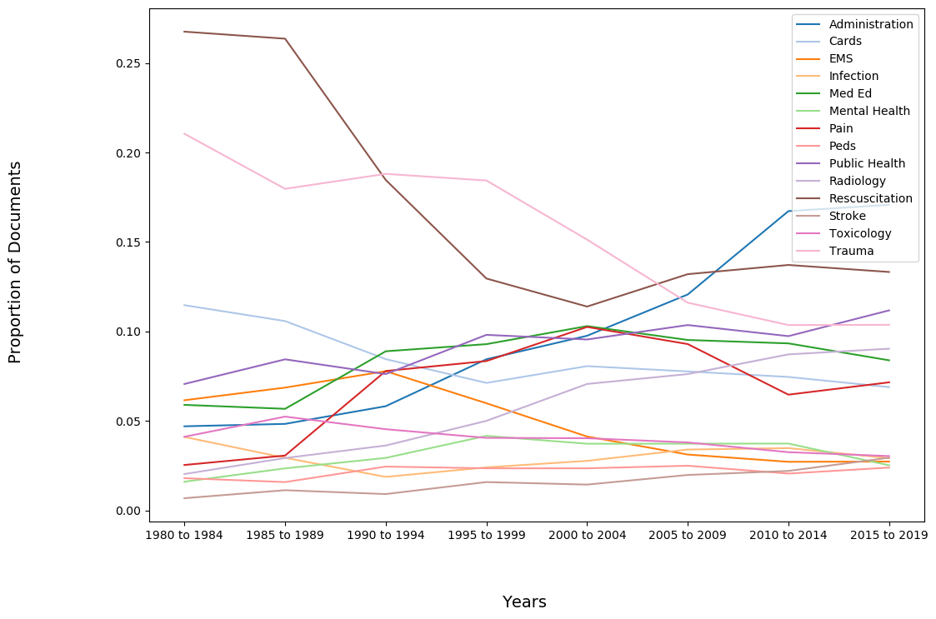
Figure 4 Research Theme Trends

Slide 14
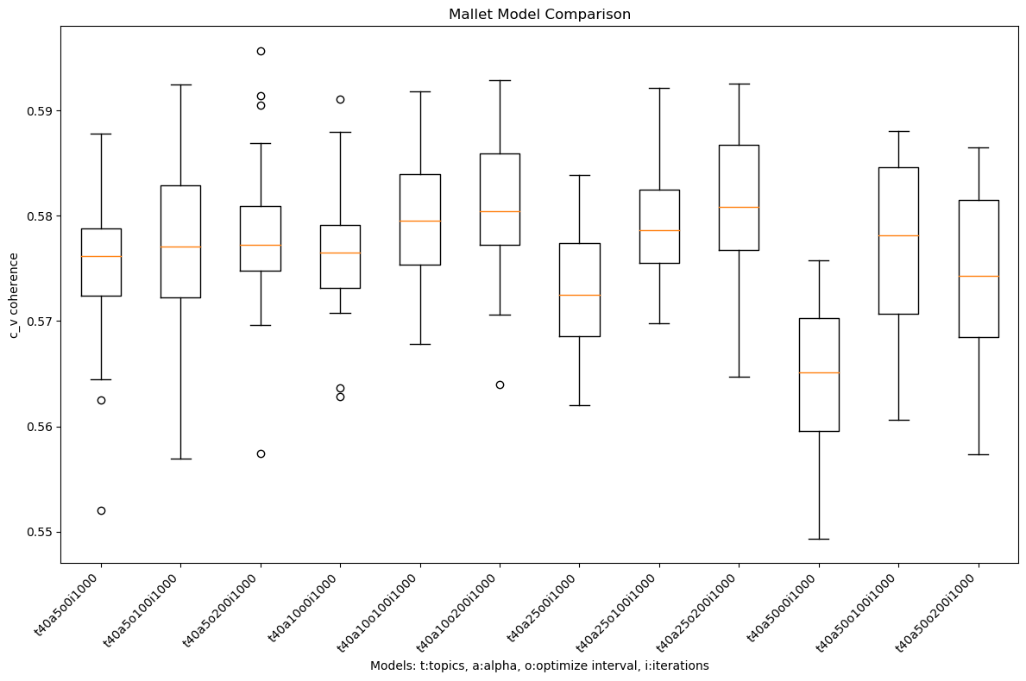
Supplemental Figure 3

Slide 15
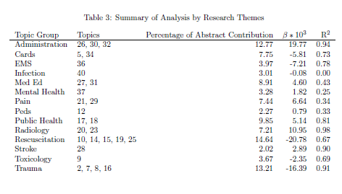
Table 3

